Slide 1






Parameter-Efficient RFMiD Retinal Disease Classification: A Calibrated Depthwise-Separable CNN Framework
CSE 754
Presented BY:
GROUP 16
Mithila Arman
23266024
Sumaya Rahman
23273006

Slide 2

Introduction
Retinal fundus imaging is widely used to screen multiple vision-threatening diseases, and these conditions can co-exist in one eye, so the task is naturally multi-label.
Real deployment is hard because models often learn domain-specific cues (camera/site/illumination), causing performance drops on unseen datasets.
The paper frames the problem as 8-label multi-label classification: N, D, G, C, A, H, M, O.
It evaluates robustness using a domain generalization setup: train on ODIR + RFMiD v2, test on held-out RFMiD v1.
It proposes an end-to-end pipeline combining label harmonization, an efficient CNN, robustness training (Mixup/CutMix), imbalance-aware loss, and EMA evaluation.
Page 01

Slide 3
Contribution
Proposes a cross-dataset evaluation pipeline (ODIR + RFMiD v2 → RFMiD v1) to test robustness under distribution shift.
Introduces RetinaEffCNN, a compact depthwise-separable / inverted-residual CNN for 8-label retinal classification.
Uses architectural robustness features: squeeze-and-excitation attention and stochastic depth.
Adds training strategies for robustness and imbalance: inter-domain Mixup/CutMix, Asymmetric Loss + class weights, light label smoothing, and EMA.
Applies per-class threshold tuning on validation, then keeps thresholds fixed when testing on the unseen domain.
Page 02

Slide 4
Background Study
Real-world fundus screening is challenging due to multi-label disease co-occurrence and distribution shift across cameras/sites/annotations.
Uses a domain generalization protocol: train on ODIR + RFMiD v2, test only on RFMiD v1 (unseen target).
Defines an 8-label taxonomy (N, D, G, C, A, H, M, O) with sigmoid outputs from 8 logits.
Performs label harmonization between datasets (map core diseases; aggregate unmapped positives into “Other”; remove missing/duplicate noise).
Uses “fast” preprocessing/augmentation and handles imbalance with ASL + weights, stabilized by AdamW + warmup/cosine and EMA; evaluates using mAUC/mAP/Macro-F1 with tuned thresholds.
Page 03

Slide 5
Related Work
Earlier systems mainly use CNN transfer learning backbones (ResNet, DenseNet, EfficientNet, MobileNet); newer ones also explore transformers (ViT, Swin, ConvNeXt-style).
The paper benchmarks many standard backbones (Swin-T, ConvNeXt-Tiny, MobileNetV3, EfficientNet variants, ViT-B/16, ResNet-50/101, DenseNet-121, RegNet) against RetinaEffCNN.
Recent multi-label fundus work emphasizes stronger heads/fusion (paired-eye feature integration, EfficientNet + MLDecoder) and broader multi-disease screening pipelines.
Domain shift is a major theme: performance drops across camera/site changes motivate domain generalization and test-time adaptation approaches.
For multi-label imbalance, Asymmetric Loss is commonly used because it reduces the effect of easy negatives while keeping learning on rare positives
Page 04

Slide 6
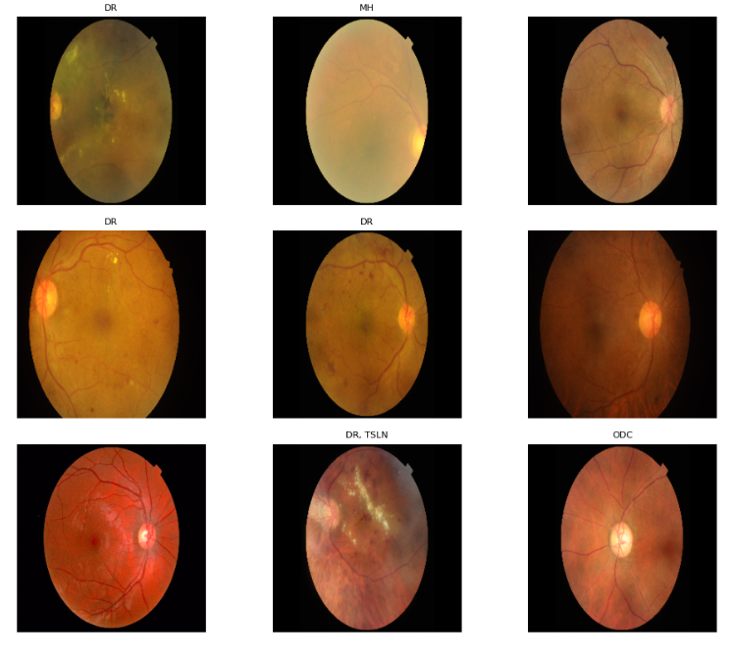
Dataset Overview
Retinal Disease Classification
3200 images for 46 different diseases
Uses a cross-dataset domain generalization setup: train on ODIR + RFMiD v2, and test only on RFMiD v1 (held-out target domain).
Follows the official dataset partitions: ODIR & RFMiD v2 provide train/val splits; RFMiD v1 is reserved for testing.
Defines an 8-label multi-label task: Normal (N), DR (D), Glaucoma (G), Cataract/MH proxy (C), AMD (A), HTN/HR proxy (H), Myopia (M), Other (O).
Applies label harmonization across datasets (e.g., DR→D, ODC→G, MH→C, ARMD→A, MYA→M, HTN/HR→H; unmapped positives → Other).
During harmonization, assigns ODIR labels to left/right eyes when present and cleans IDs by handling extensions, removing duplicates, and dropping missing files.

Slide 7
Dataset Overview
3200 images for 46 different diseases
  Diabetic retinopathy (DR)
  Age-related macular degeneration (ARMD)
  Media Haze (MH)
  Drusens (DN)
  Myopia (MYA)
  Branch retinal vein occlusion (BRVO)
  Tessellation (TSLN)
  Epiretinal membrane (ERM)
  Laser scars (LS)
  Macular scar (MS)
  Central serous retinopathy (CSR)
  Optic disc cupping (ODC)
  Central retinal vein occlusion (CRVO)
  Tortuous vessels (TV)
  Asteroid hyalosis (AH)
  Optic disc pallor (ODP)
  Optic disc edema (ODE)
  Shunt (ST)
  Anterior ischemic optic neuropathy (AION)
  Parafoveal telangiectasia (PT)
  Retinal traction (RT)
  Retinitis (RS)
  Chorioretinitis (CRS)
  Exudation (EDN)
  Retinal pigment epithelium changes (RPEC)
  Macular hole (MHL)
  Retinitis pigmentosa (RP)
  Cotton-wool spots (CWS)
  Coloboma (CB)
  Optic disc pit maculopathy (ODPM)
  Preretinal hemorrhage (PRH)
  Myelinated nerve fibers (MNF)
  Hemorrhagic retinopathy (HR)
  Central retinal artery occlusion (CRAO)
  Tilted disc (TD)
  Cystoid macular edema (CME)
  Post-traumatic choroidal rupture (PTCR)
  Choroidal folds (CF)
  Vitreous hemorrhage (VH)
  Macroaneurysm (MCA)
  Vasculitis (VS)
  Branch retinal artery occlusion (BRAO)
  Plaque (PLQ)
  Hemorrhagic pigment epithelial detachment (HPED)
  Collateral (CL)

Slide 8
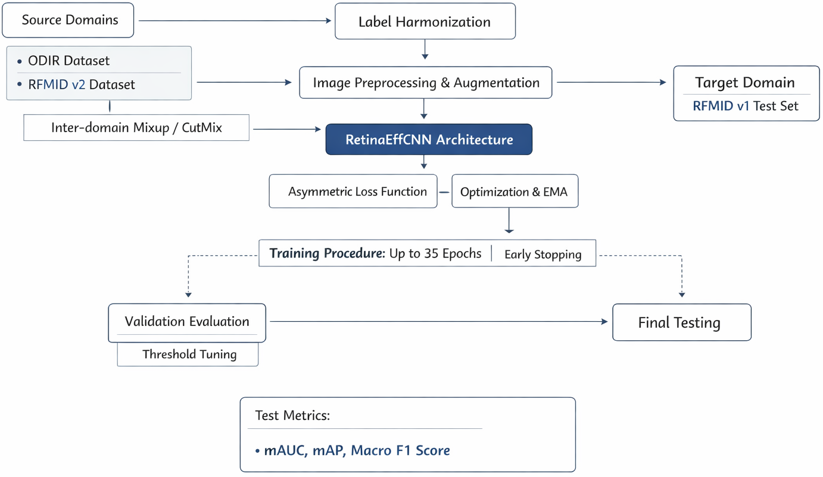
Proposed Methodology

Slide 9
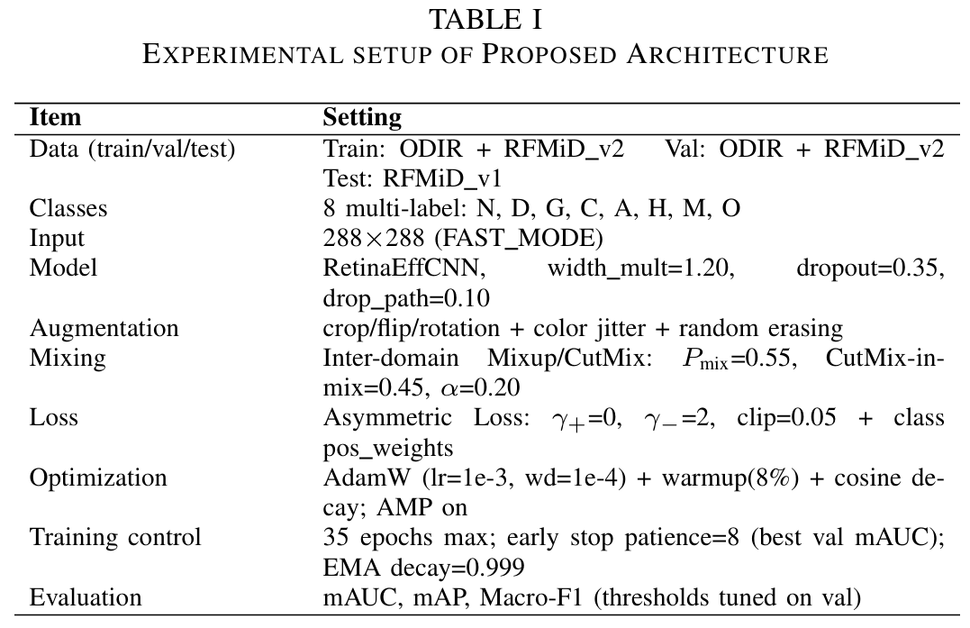
Implementation

Slide 10
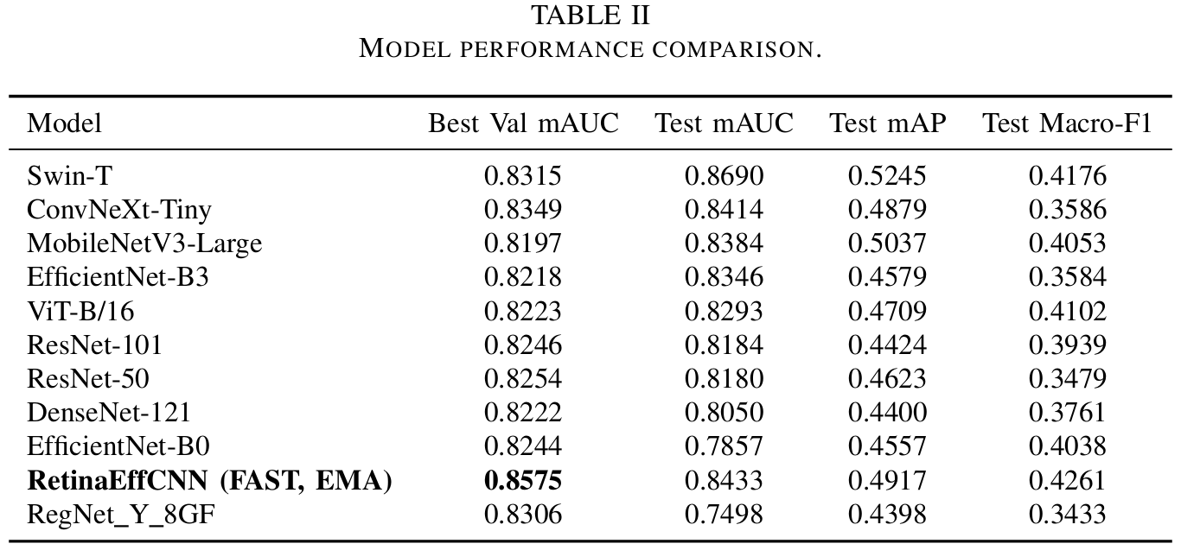
Results and Discussion

Slide 11
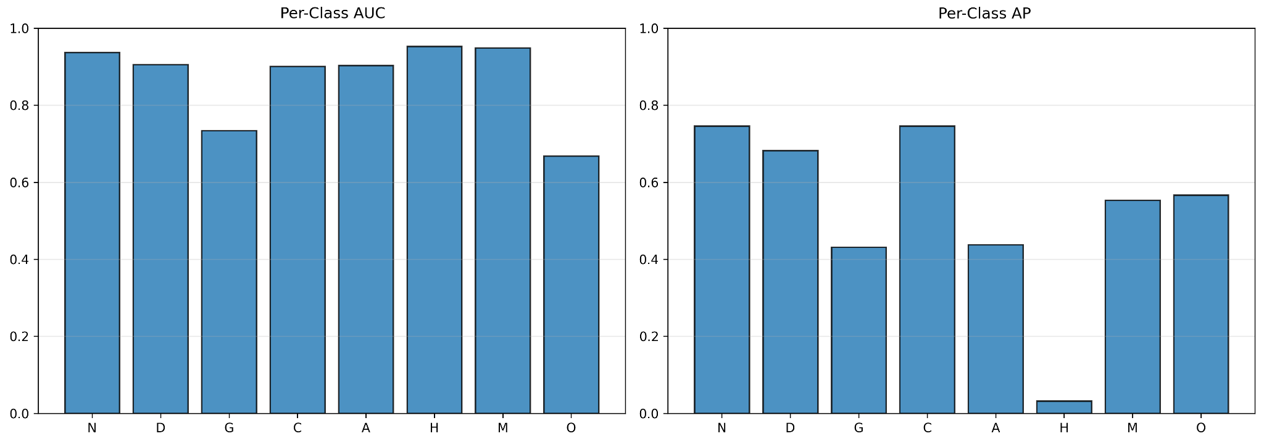
Results and Discussion

Slide 12
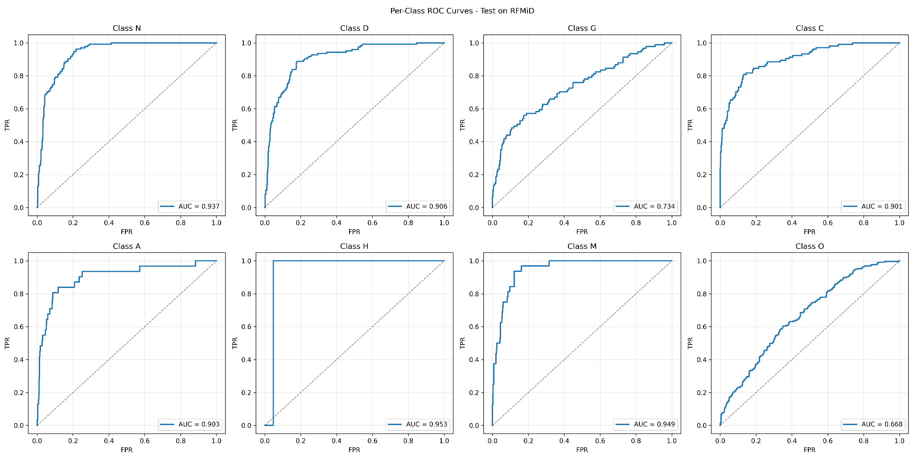
Results and Discussion

Slide 13
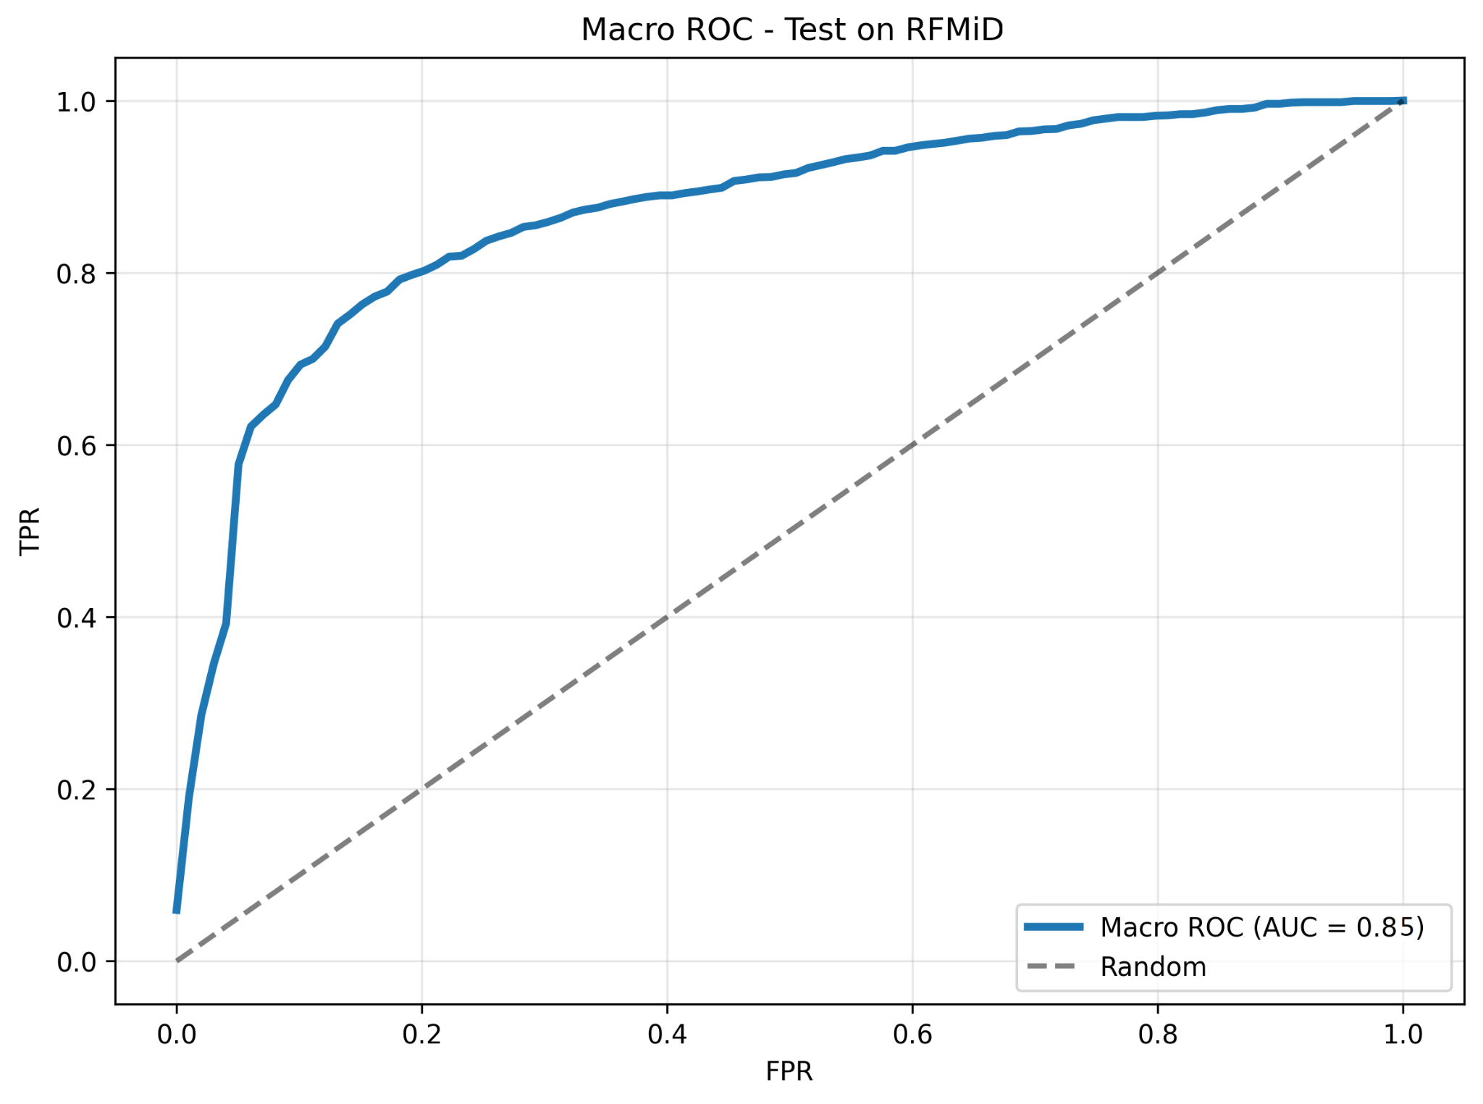
Results and Discussion

Slide 14
Conclusion
Presents a parameter-efficient pipeline for cross-dataset domain generalization in multi-label retinal disease classification.
Trains on ODIR + RFMiD v2 and evaluates only on the unseen RFMiD v1 target domain to test real robustness.
Uses an 8-label harmonized disease space, including an aggregated “Other” label to keep unmapped pathology signals.
Combines an efficient RetinaEffCNN backbone with robustness training: inter-domain Mixup/CutMix, ASL with imbalance handling, and EMA.
Results show a trade-off: RetinaEffCNN gets the best test Macro-F1, while a stronger transformer (Swin-T) can lead on test mAUC.
Page 10

Slide 15
Future Work
Run clean ablation studies to measure how much each component (harmonization, mixing, ASL reweighting, EMA, FAST knobs) contributes.
Expand calibration analysis using reliability metrics (ECE/Brier) and stronger thresholding / post-hoc calibration.
Test compute-aware upgrades such as TTA and lightweight ensembles.
Broaden evaluation to more external target datasets, plus deeper error/explainability checks for clinically plausible cues.
Explore initializing or distilling from recent retinal foundation / vision-language models (RETFound, RETFound-Green, FLAIR, EyeCLIP) guided by DG surveys for medical imaging.
Page 10

Slide 16
THANKS
FOR YOUR ATTENTION

